Slide 1
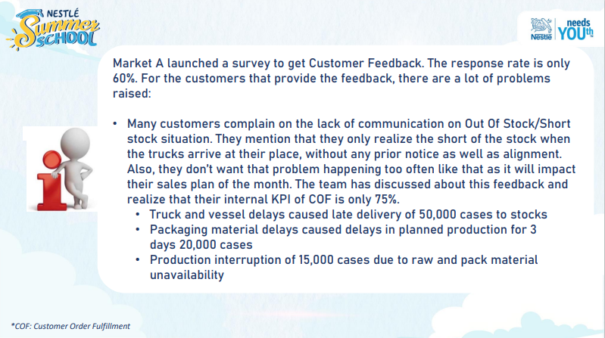
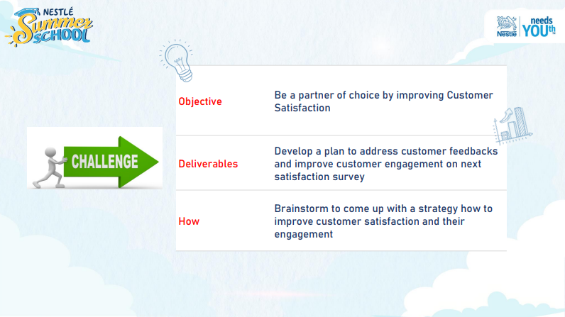
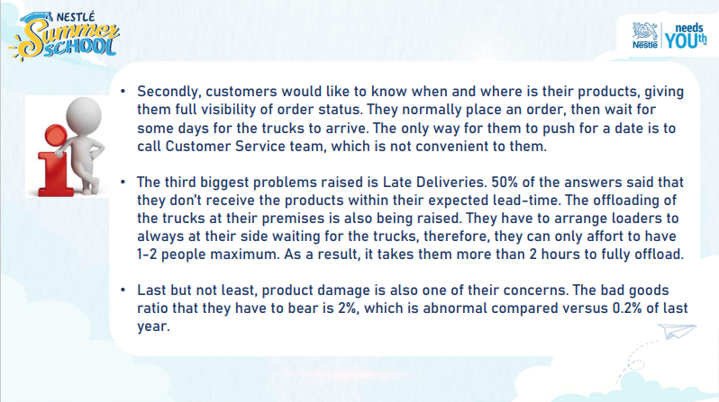
CASE STUDY
NESTLÉ SUMMER SCHOOL 2023
SUPPLY CHAIN FUNCTION – FINAL TEST
Market A launched a survey to get Customer Feedback. The response rate is only 60%. For the customers that provide the feedback, there are a lot of problems raised:
1/ Many customers complain on the lack of communication on Out Of Stock/Short stock situation. They mention that they only realize the short of the stock when the trucks arrive at their place, without any prior notice as well as alignment. Also, they don’t want that problem happening too often like that as it will impact their sales plan of the month. The team has discussed about this feedback and realize that their internal KPI of COF is only 75%.
Truck and vessel delays caused late delivery of 50,000 cases to stocks
Packaging material delays caused delays in planned production for 3 days 20,000 cases
Production interruption of 15,000 cases due to raw and pack material unavailability
COF: Customer Order Fulfillment
2/ Secondly, customers would like to know when and where is their products, giving them full visibility of order status. They normally place an order, then wait for some days for the trucks to arrive. The only way for them to push for a date is to call Customer Service team, which is not convenient to them.
3/ The third biggest problems raised is Late Deliveries. 50% of the answers said that they don’t receive the products within their expected lead-time. The offloading of the trucks at their premises is also being raised. They have to arrange loaders to always at their side waiting for the trucks, therefore, they can only affort to have 1-2 people maximum. As a result, it takes them more than 2 hours to fully offload.
4/ Last but not least, product damage is also one of their concerns. The bad goods ratio that they have to bear is 2%, which is abnormal compared versus 0.2% of last year.

Slide 2
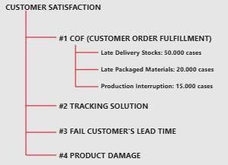
Requirements
EXPLAIN CASE
Structure and Prioritize Problem
The main purpose of this case that how to improve %Customer Satisfaction.
According to case study, there are four criteria with ranking category from more to less importance. Current information:
Customer Satisfaction: 60%, COF: 75%, Tracking Solution: NO
Fail Customer’s Lead time: 50%, Product Damaged: 2%

Slide 3
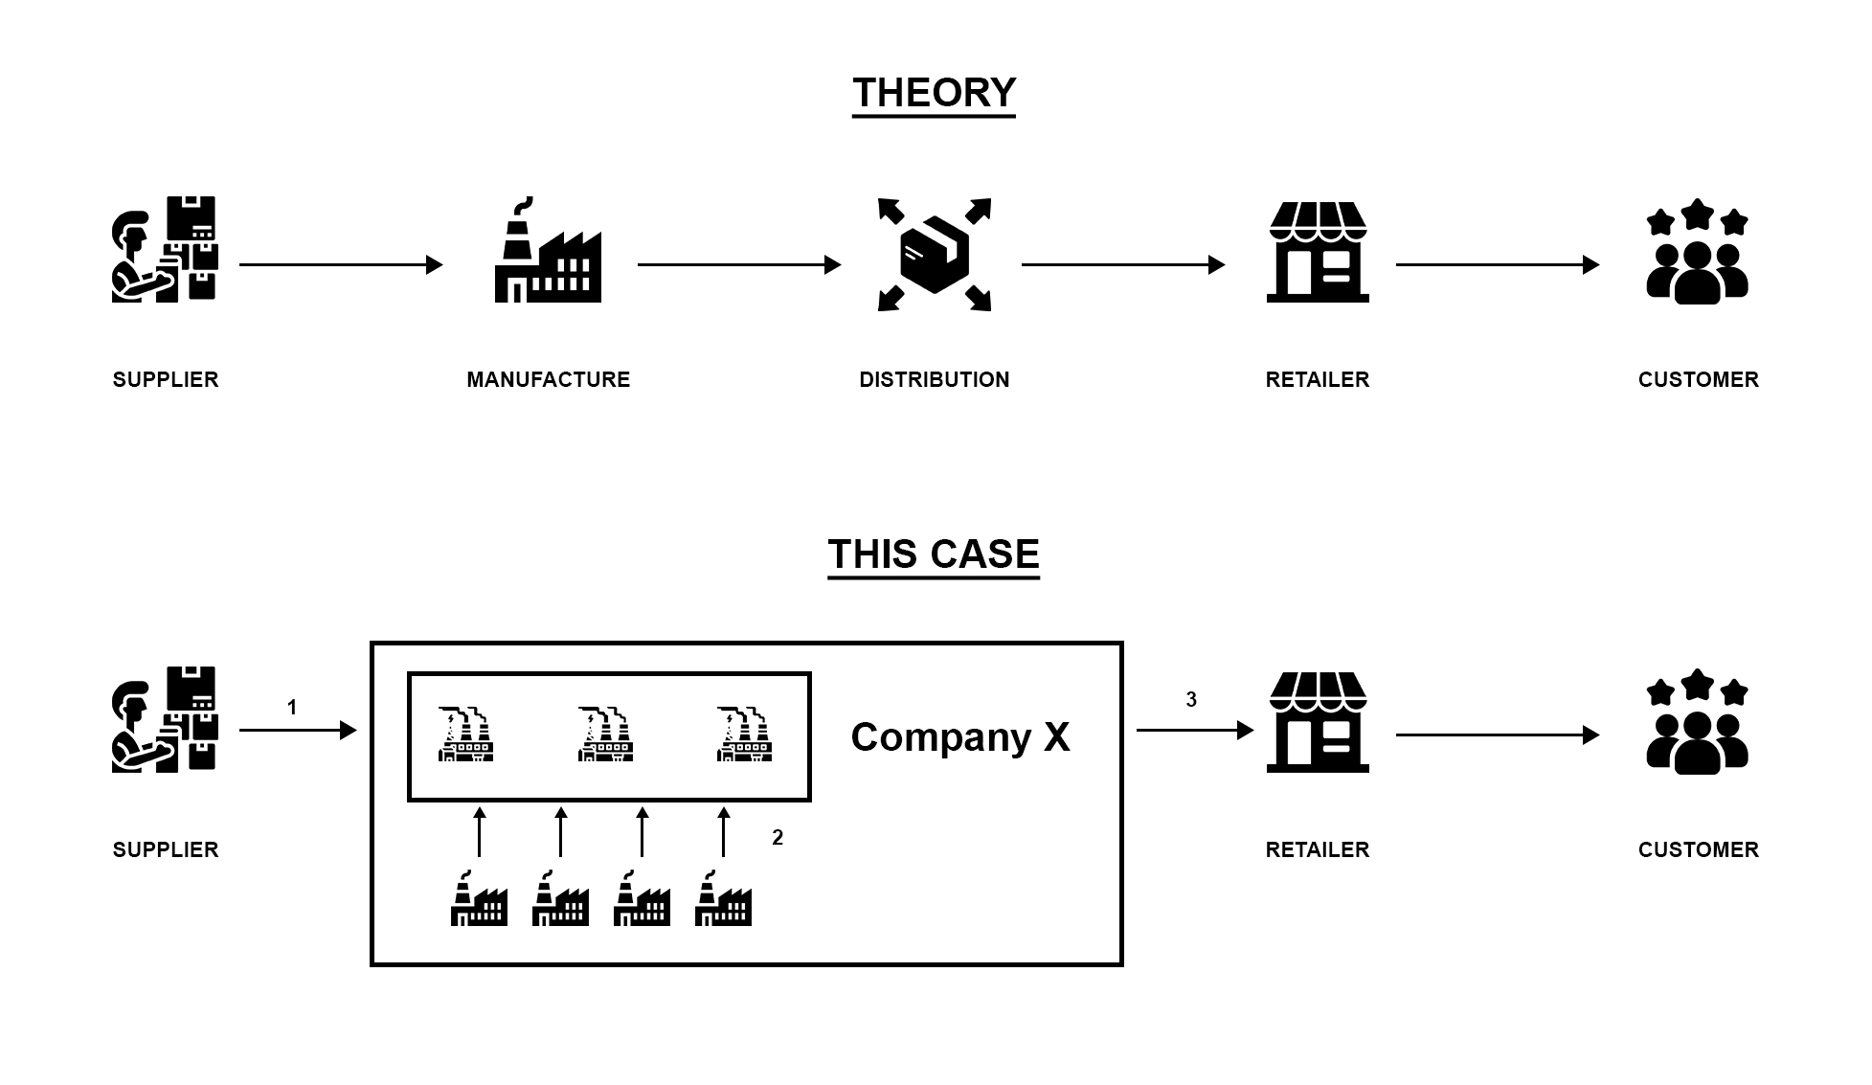
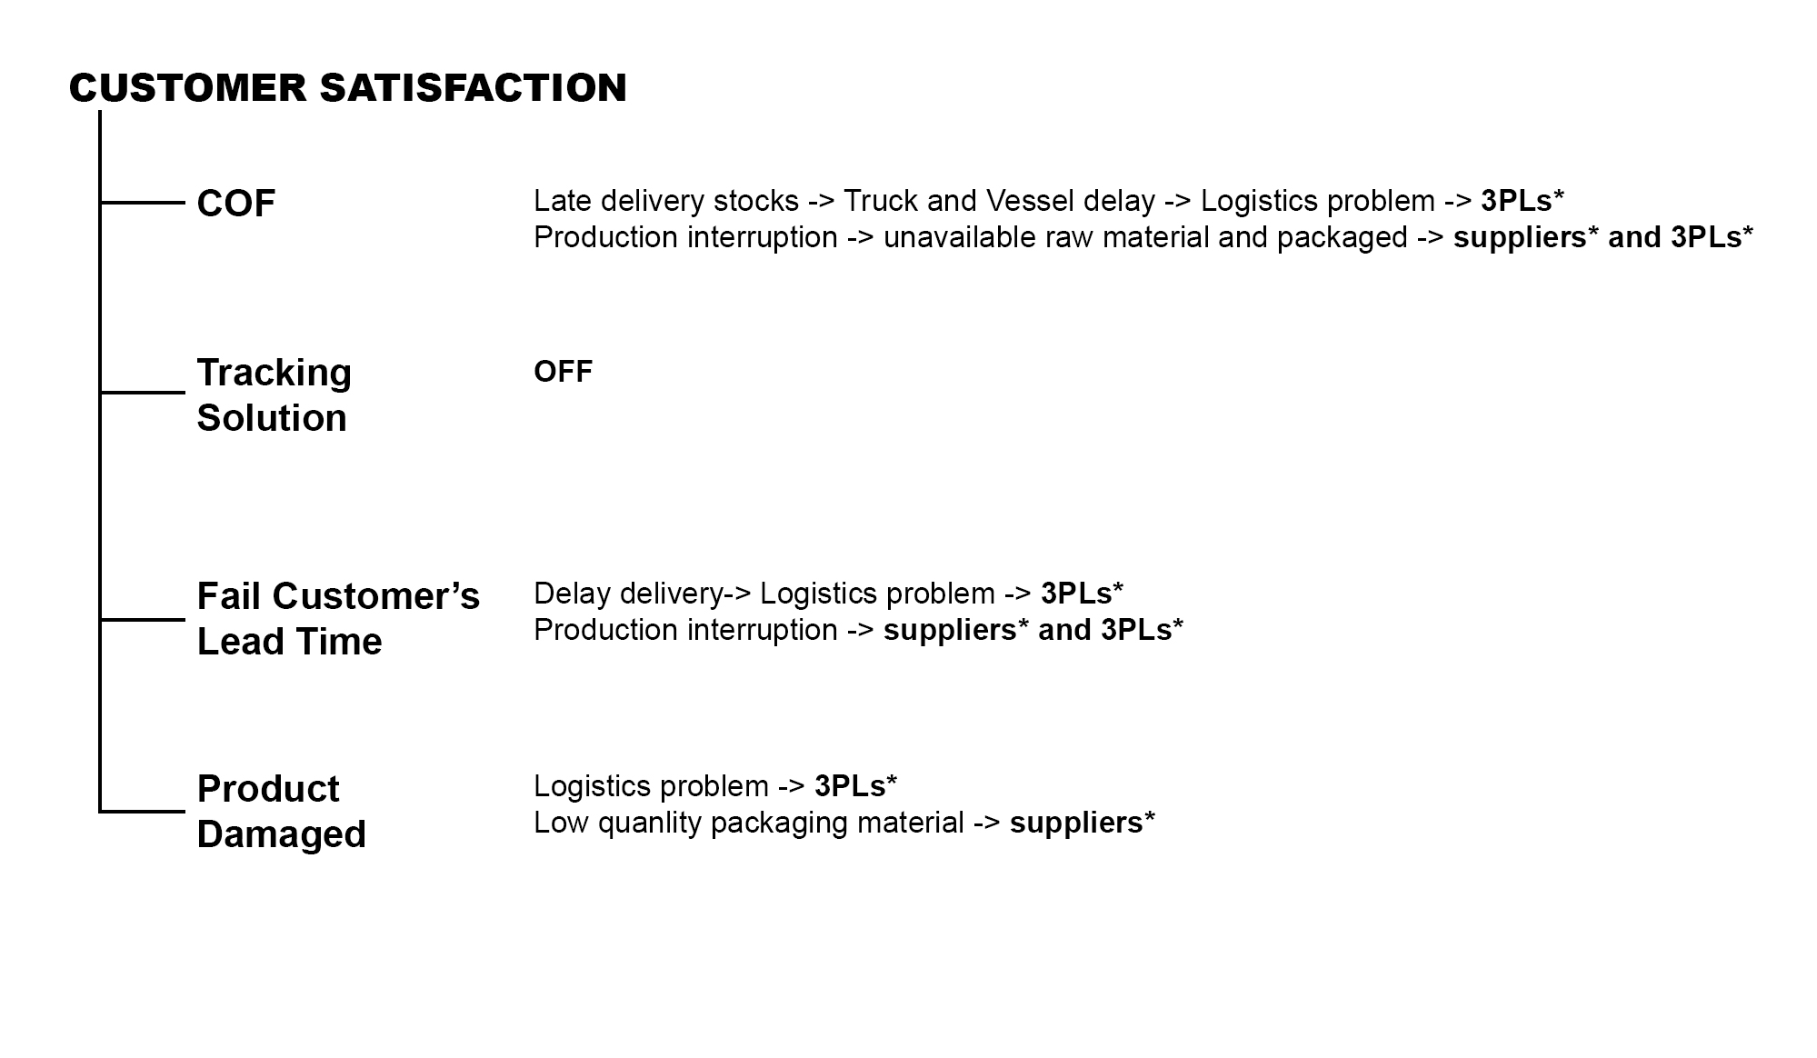
Suppose Supply Chain Flow
EXPLAIN CASE
Roots of issue
100 Suppliers to Company X in two type material
4 other Manufactures to Company X in stocks (final products)
Company X to Retailers
All of shipments were carried by 9 3PLs, Company X paid for them
The roots of issue that the quality of supplier products and 3PLs services.
Suppose we have good suppliers, the main purpose of this case that 3PLs evaluation.

Slide 4
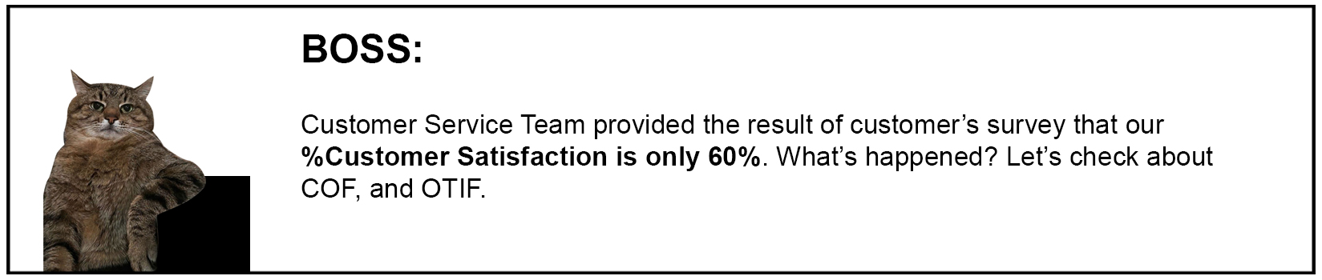
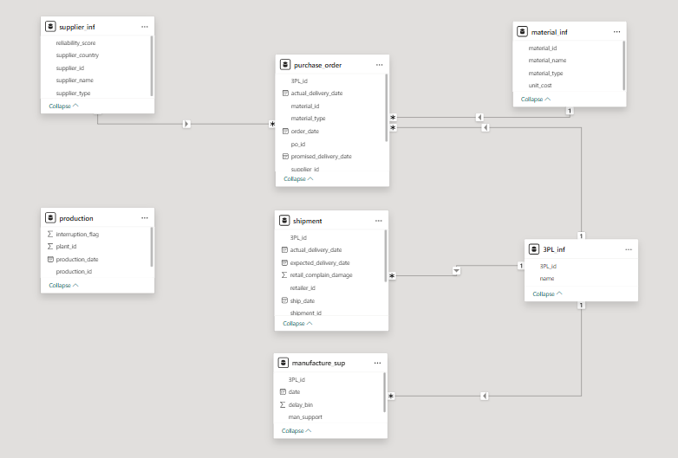
Created 2025 Simulation Dataset
DESCRIPTIVE
Make Relationship
To give a clear research method, I decided to create 8 datasets to records the case study clues
According to basic information of dataset, there are relationship of 8 datasets that were set up on Power BI.

Slide 5
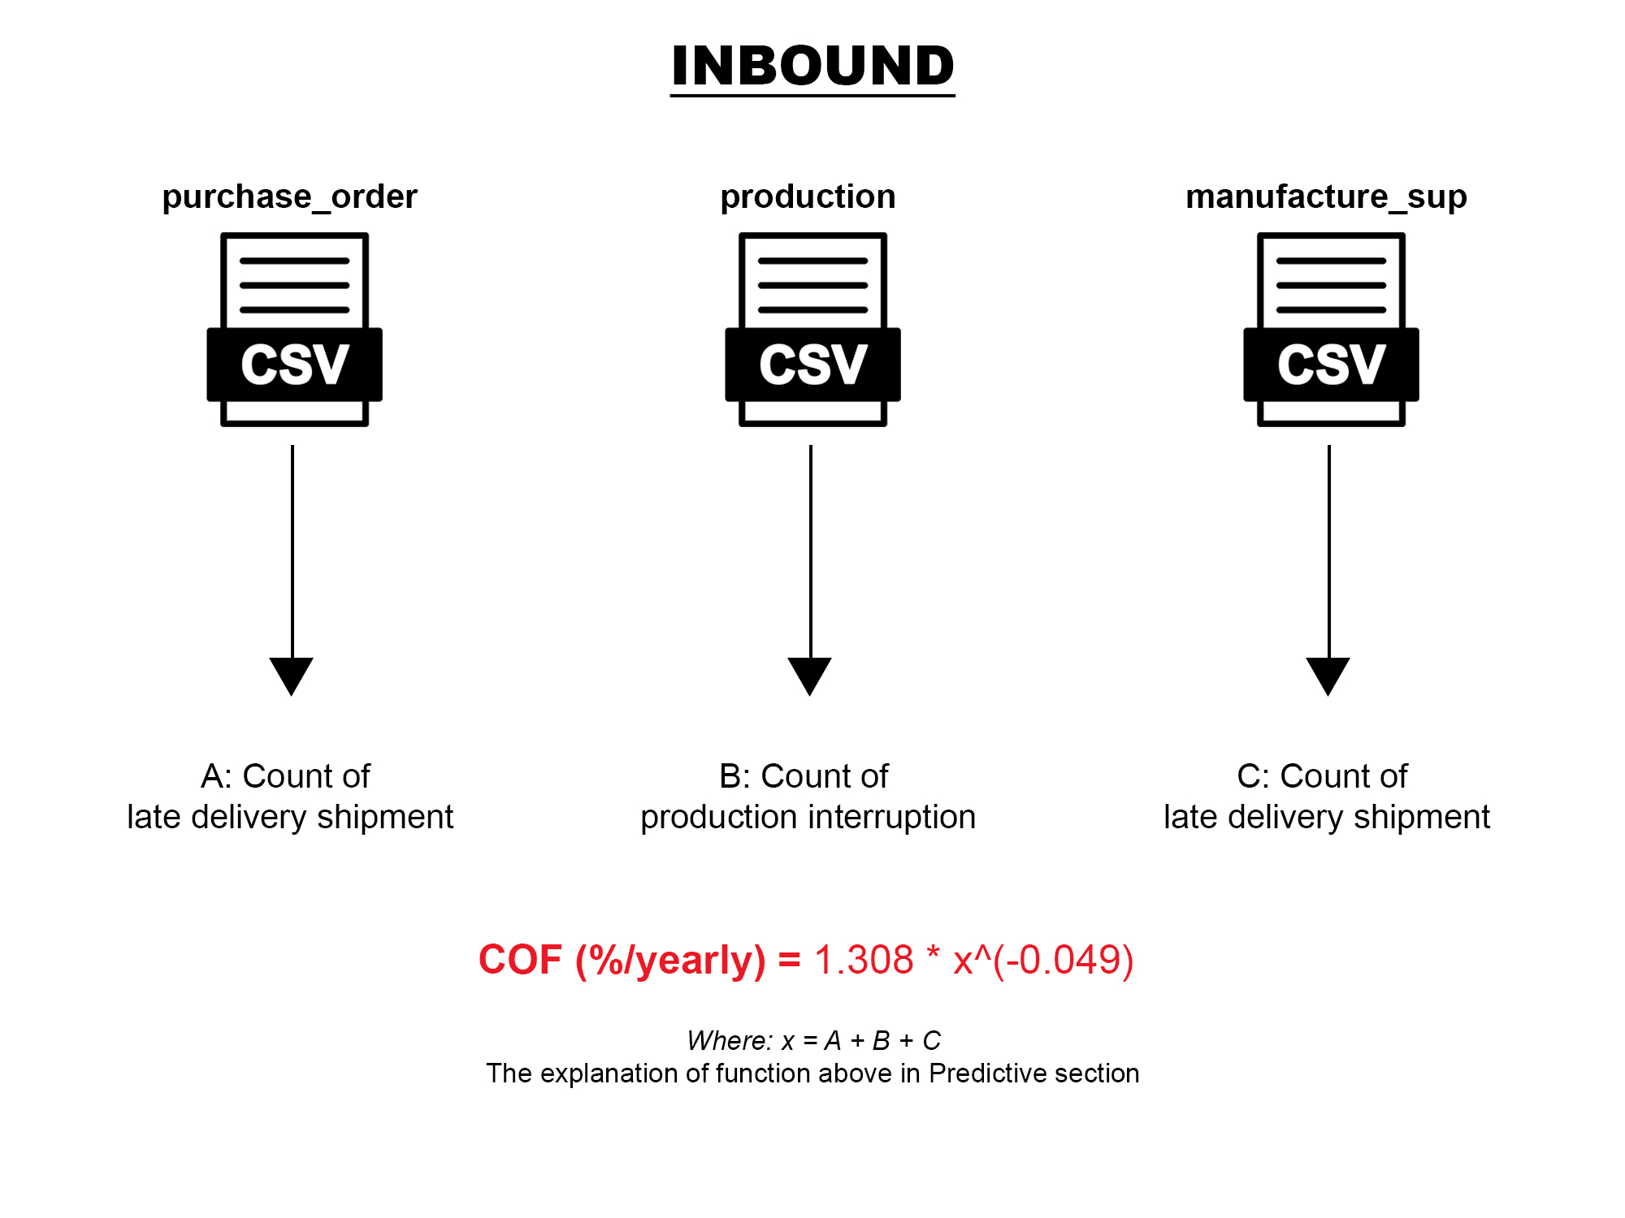
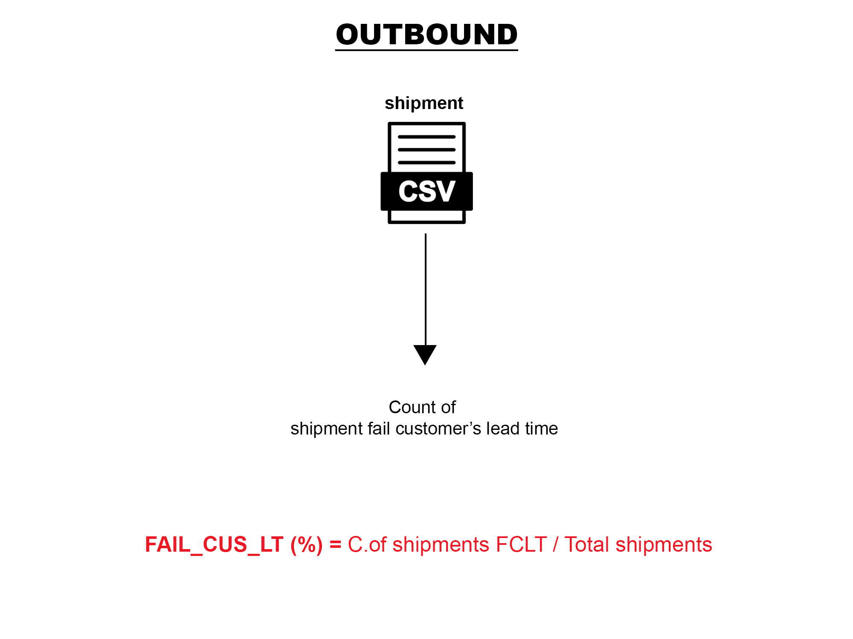
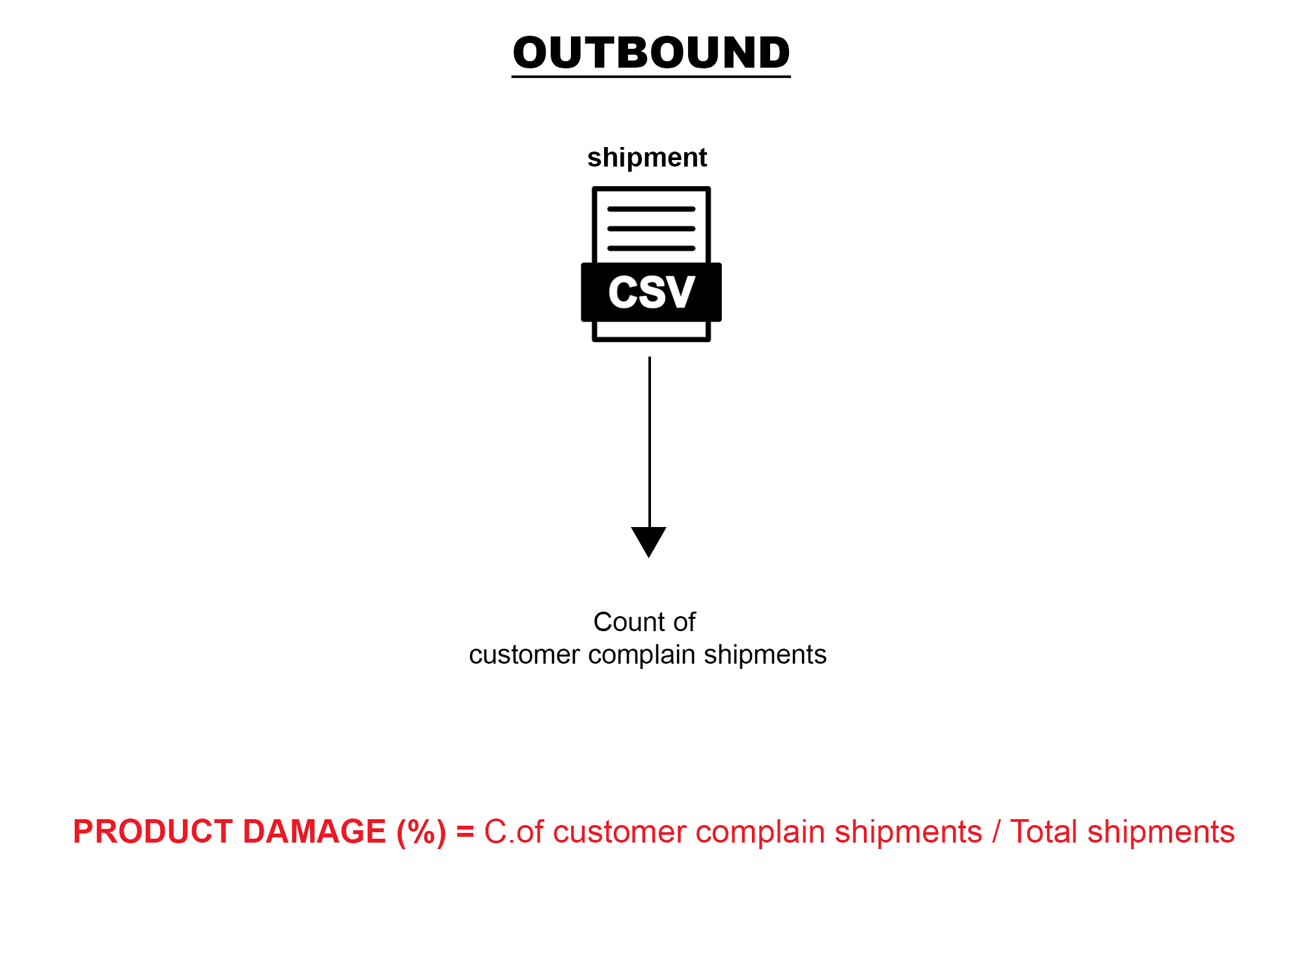
Using DAX to create measures
DESCRIPTIVE
To view the Customer Satisfaction’s criteria in 2025, I created measures on Power BI.

Slide 6
Customer Satisfaction Function
DESCRIPTIVE
According to information in this case, I created the function base on the percentage sharing of criteria.

Slide 7
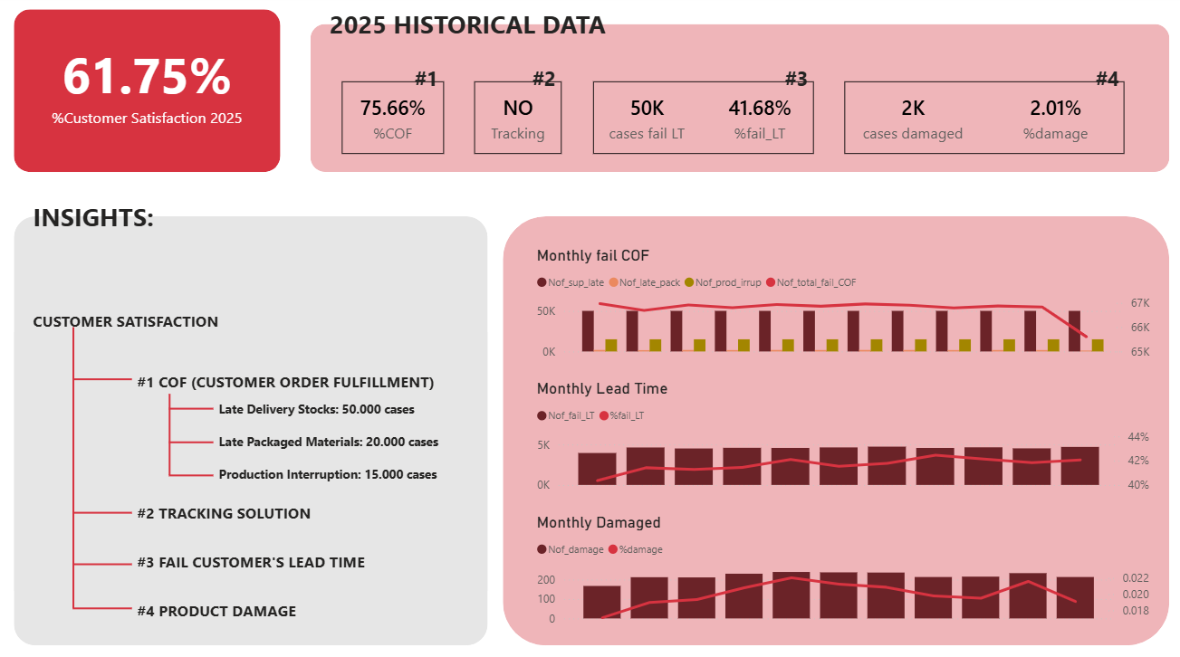
BI Descriptive Dashboard
DESCRIPTIVE
Dashboard above shows the summary of customer satisfaction performance in 2025 (that nearly fit with the information of Nestlé case). Based on that, we can view the current %Customer Satisfaction in only 61.75%.
The other way to use descriptive dashboard that apply new dataset with same structure to view the details information month-by-month for tracking when apply new policy, method.

Slide 8
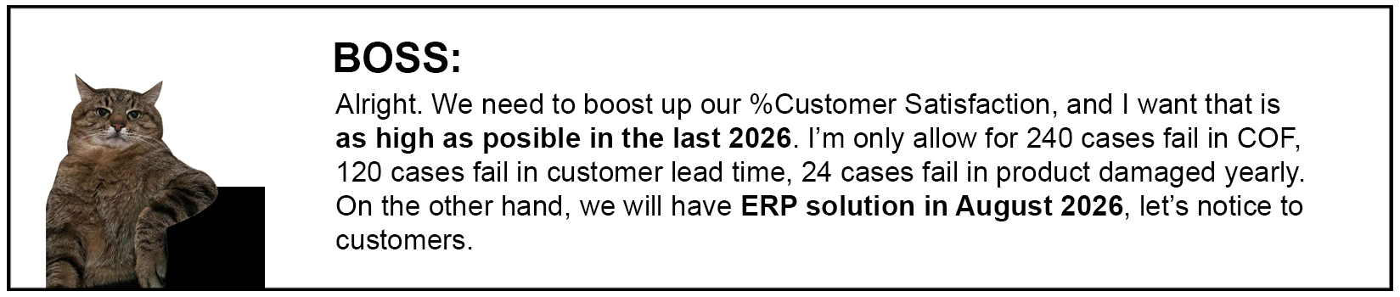
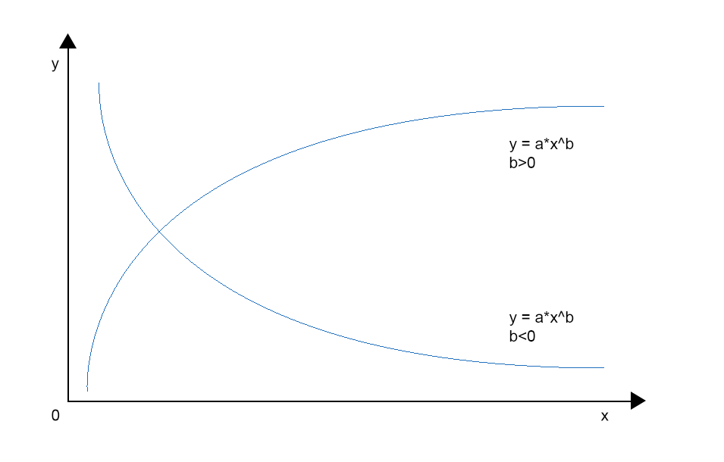
Power Model
PREDICTIVE
Because criteria are rating in percentage, to hit 100% is impossible. Therefore, they are following the power function.

Slide 9
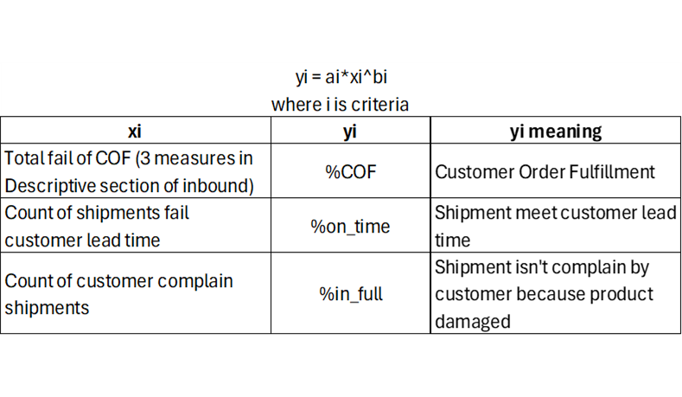
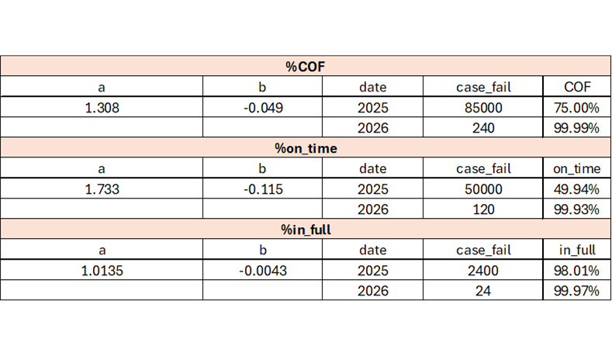
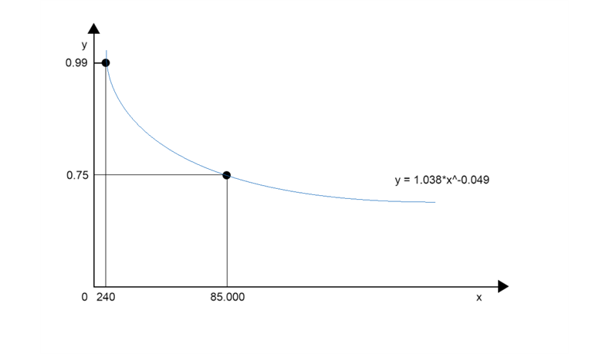
Yearly Predictive Model
PREDICTIVE
Based on the requirement, we have two information to find model that are historical data and target (calculate monthly to yearly by multiple with 12).
After that, we easily find three yearly models for criteria.

Slide 10
Predictive Model (Yearly to Monthly)
PREDICTIVE
To set target monthly KPI, I transform yearly to monthly model. Then, I find the gap month-by-month by find r value. After that, I use the number of cases last month multiple with r value to get target this month.
In 2026, if the number of fail COF cases lower than target, it meet KPI.

Slide 11
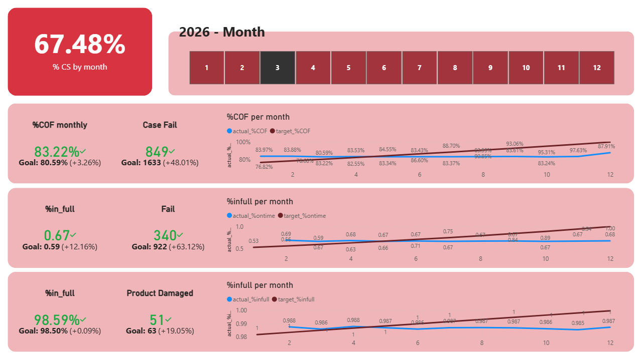
BI Dashboard
PREDICTIVE
This dashboard shows the target of 3 criteria, such as %COF, %ontime, %infull and the %Customer Satisfaction, all of them present in monthly.
Besides, I created simulated 2026 dataset for target information in KPI charts and Line charts (for overall view). In fact, this dashboard can automation upgrade when I append the newest data to dataset. So, my boss can track 2026 performance day-by-day.

Slide 12
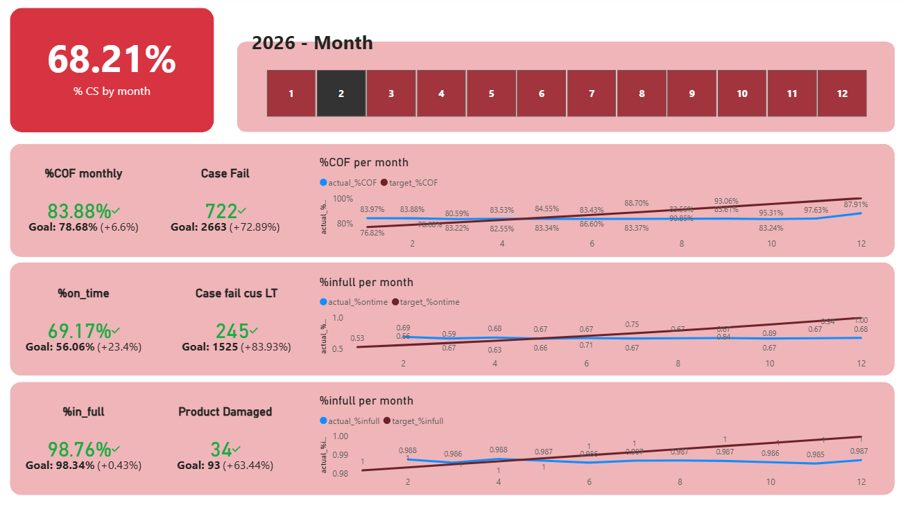
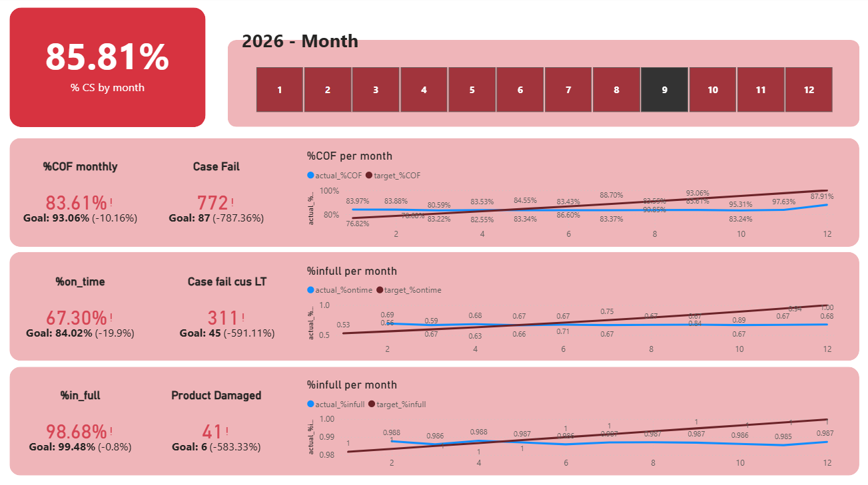
Example: View in FEB-2026
PREDICTIVE
Example: View in AUG-2026
In %KPI, three quarter meet target because the number of cases fail are lower than maximum cases fail.
But, in February 2026, company X don’t have tracking solution, the Customer Satisfaction is slightly increase to 68.21%
Three criteria below don’t meet target because the number of cases fail are out of limit. So, all color of them is red.
On the other hand, in August 2026, company X introduce the Tracking Solution for their customers, so Customer Satisfaction improve to 85.81%.

Slide 13
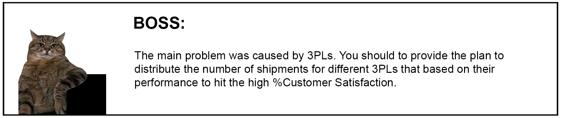
Overall 2025 historical data
PRESCRIPTIVE
Explain to performance
Using Power Query to combine datasets to a table above.
Trucking: that is regional transport in Market A (company X to retailers/ customers). Product flow number 3 in Descriptive section.
Global shipment: that is international transport to Market A (suppliers/ manufactures to Company X). Product flow number 1, 2 in Descriptive section
Using performance function that: 1 – (a/b)
Where: i is the total of shipments
j is the cases fail (late delivery, damage)
So, we can rank 3PLs based on their performance in 2025.

Slide 14
Set Objective Function
PRESCRIPTIVE
As we know that my boss want to improve %Customer Satisfaction. Clearly, %CS depended four criteria below. If the number of cases fail is decrease, %criteria will improve according power model then %CS will also increase.
So that, the objective function in this solver model that minimum cases fail of each category.

Slide 15
Set Variables
PRESCRIPTIVE
The orange cells is variables, that is the number of shipments that company X separated to nine 3PLs. Based on 3PLs performance, we can calculate the number of cases fail like late delivery and damage.

Slide 16
Set Constraints
PRESCRIPTIVE
Based on boss’s requirements, there are four important constraints to keep product flow fluency.

Slide 17
Result
PRESCRIPTIVE
As a result, the output of objective function is 52,795 cases fail
Especially, we can see the improvements of each different cases fail. It is boosted up!

Slide 18
Conclusion
PRESCRIPTIVE
Some Advise
As conclusion, we can see that there are improvements in %Customer Satisfaction and criteria when we distributed different the number of shipments to 3PLs.
In this case, to maximum the %Customer Satisfaction, we need to manage more than 9 3PLs, reach to good 3PLs to meet customer demand on time in full and our production plan.
Out of that case, we need to consider other criteria like supplier’s quality, plant production,… to improve %Customer Satisfaction continuously.

